Slide 1
Digital Clock Project
By: Tyler vergis-Mayo

Slide 2

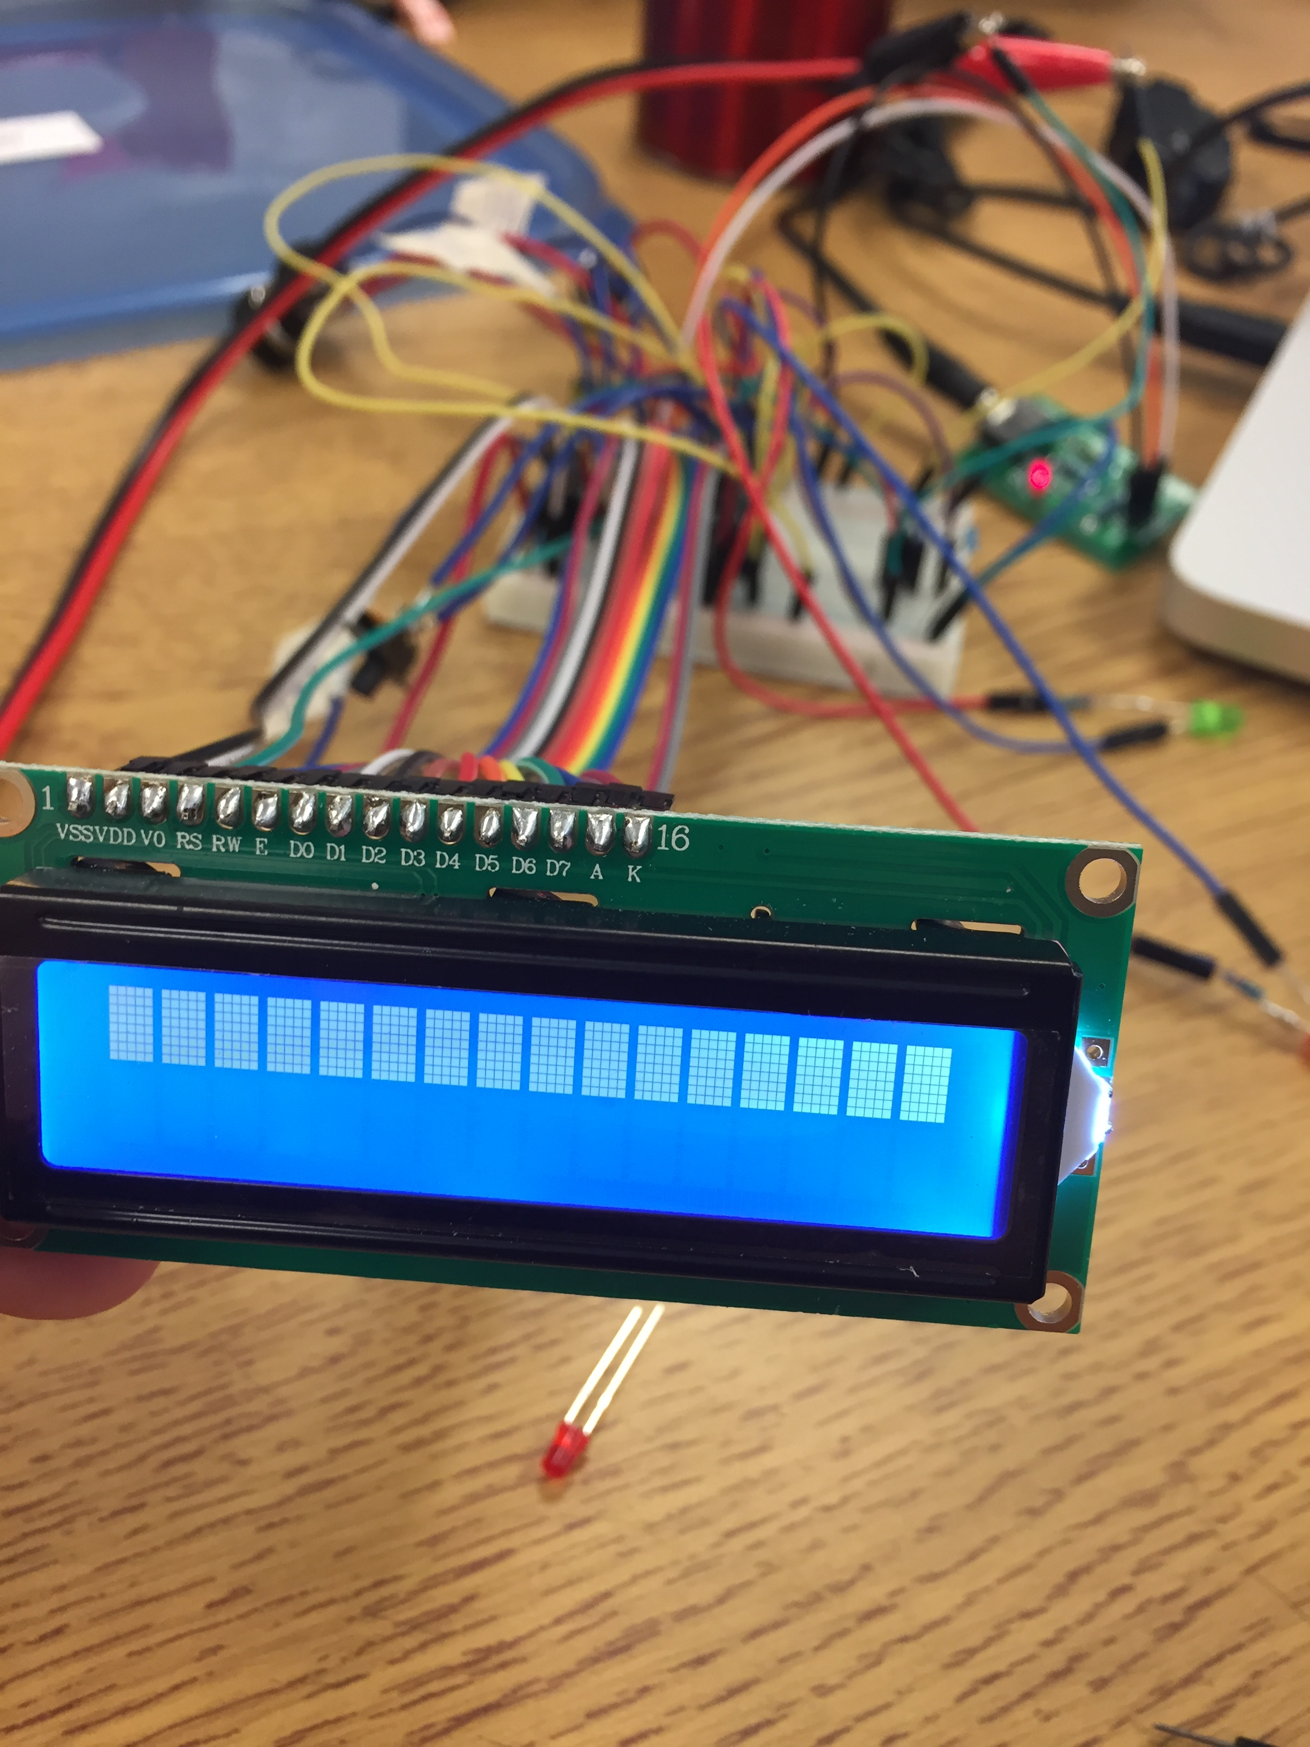
Initial Startup and Reboot
Circuit and code completed
Code successfully compiled and programmed the chip
Initial boot showed time and date and the code worked however once unplugged and plugged in again it stopped initializing the LCD SCREEN

Slide 3
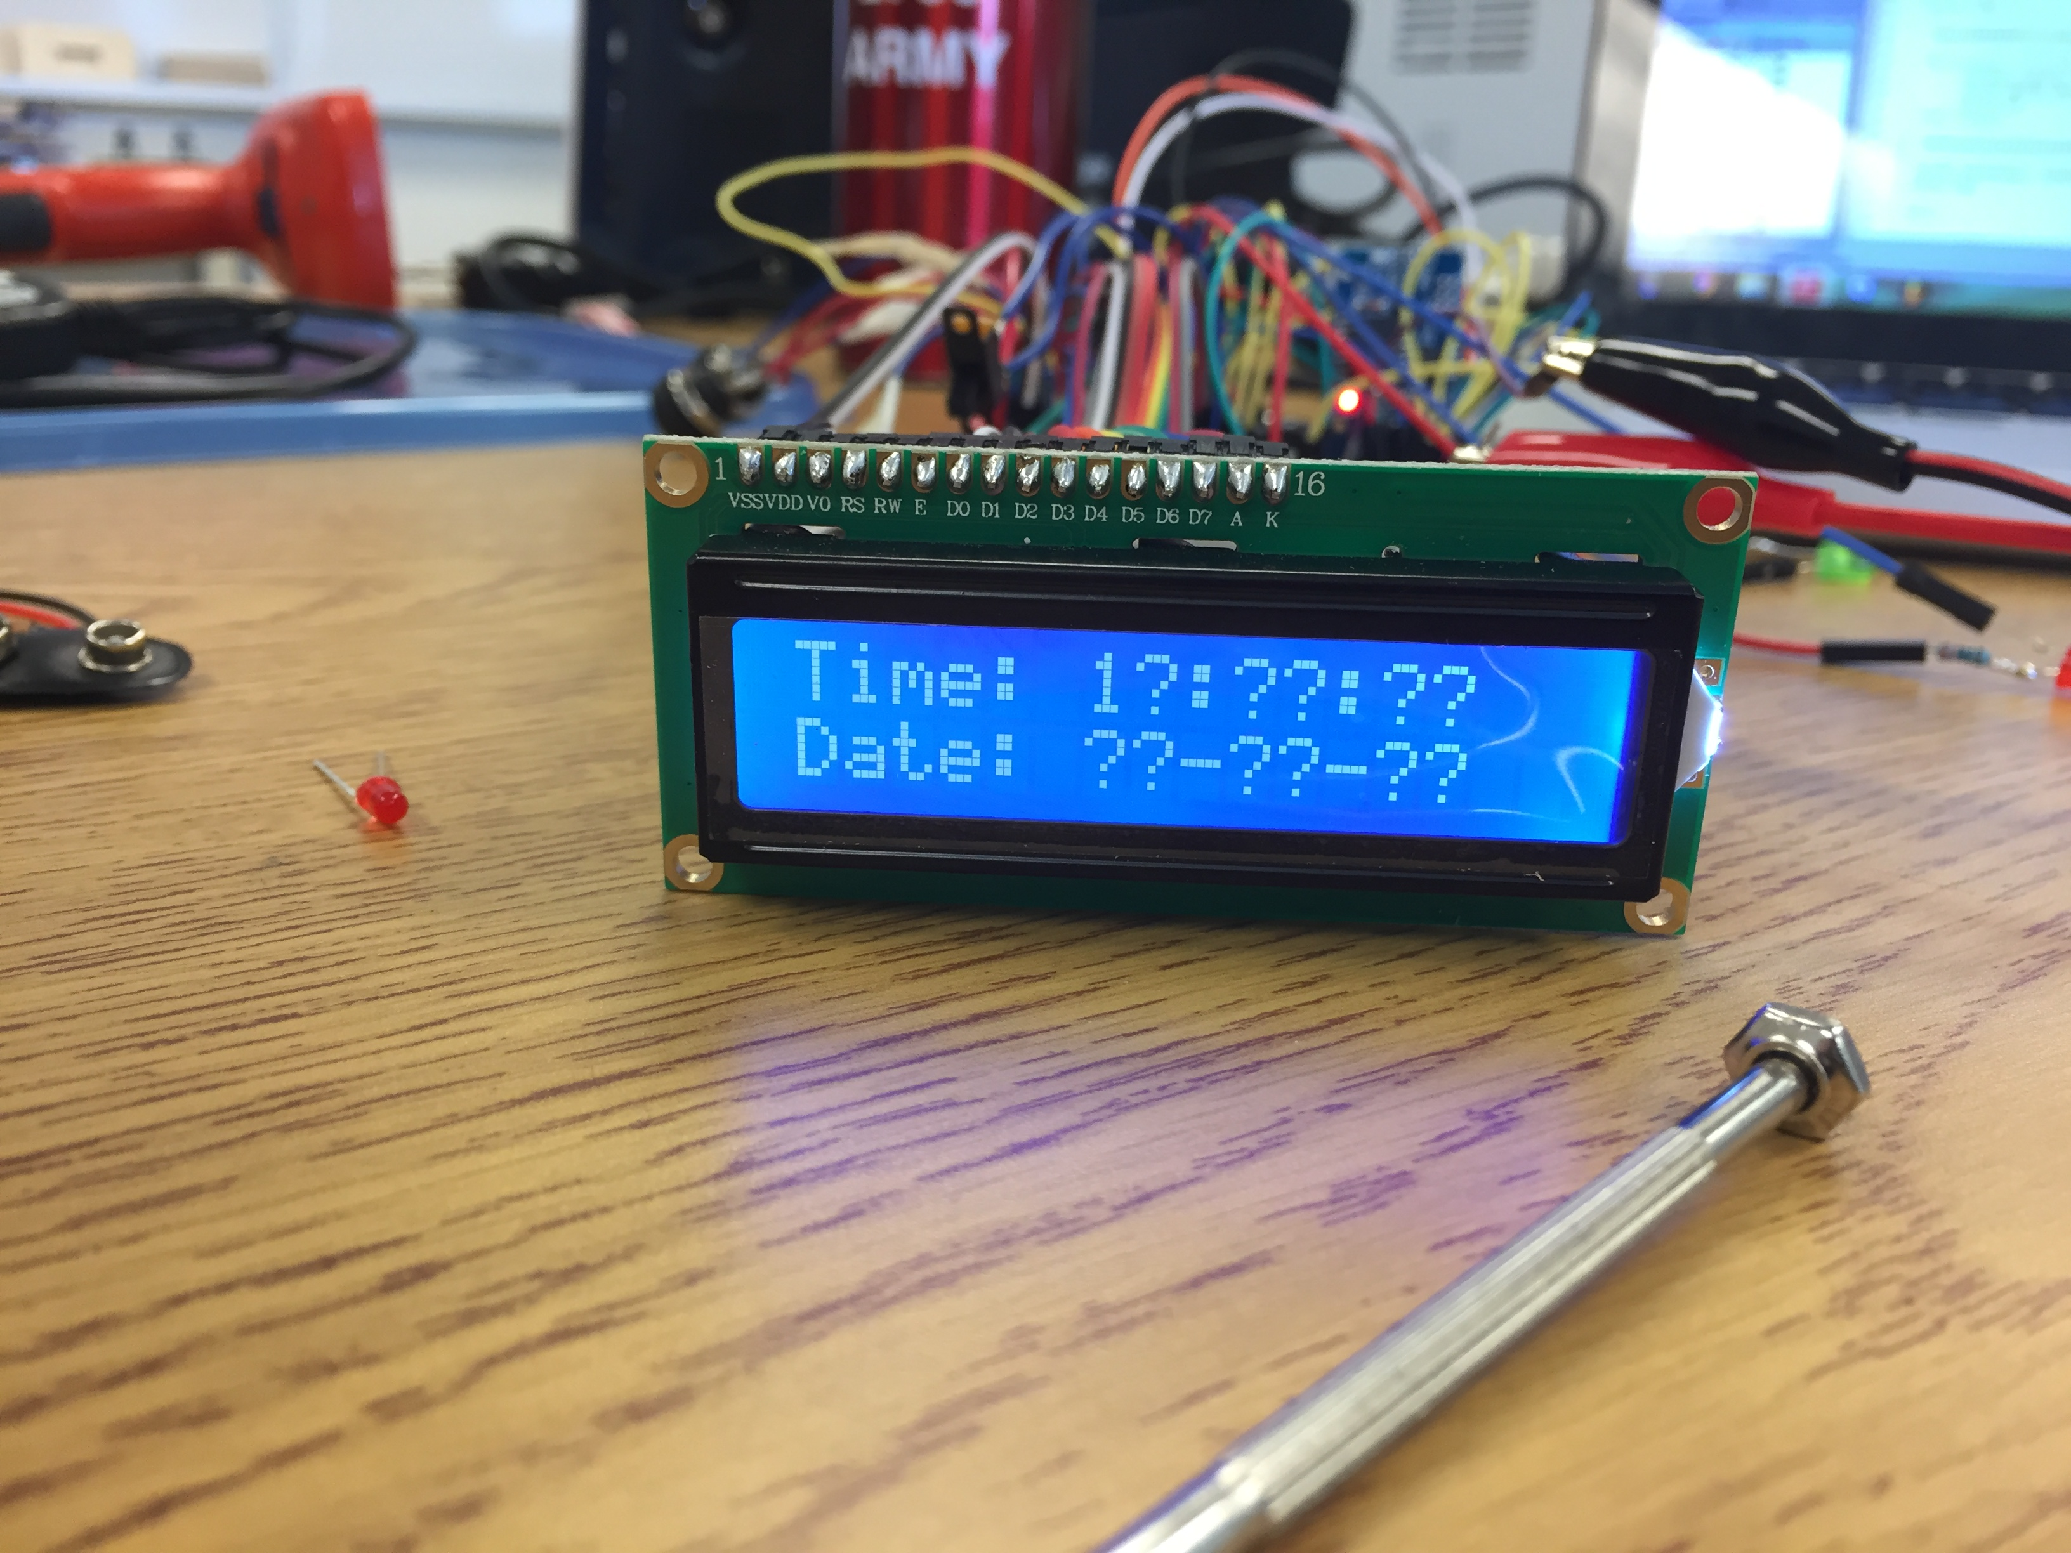
??????????
Found a few errors in my code, corrected them and the lcd now initializes
However the date and time do not display correctly

Slide 4
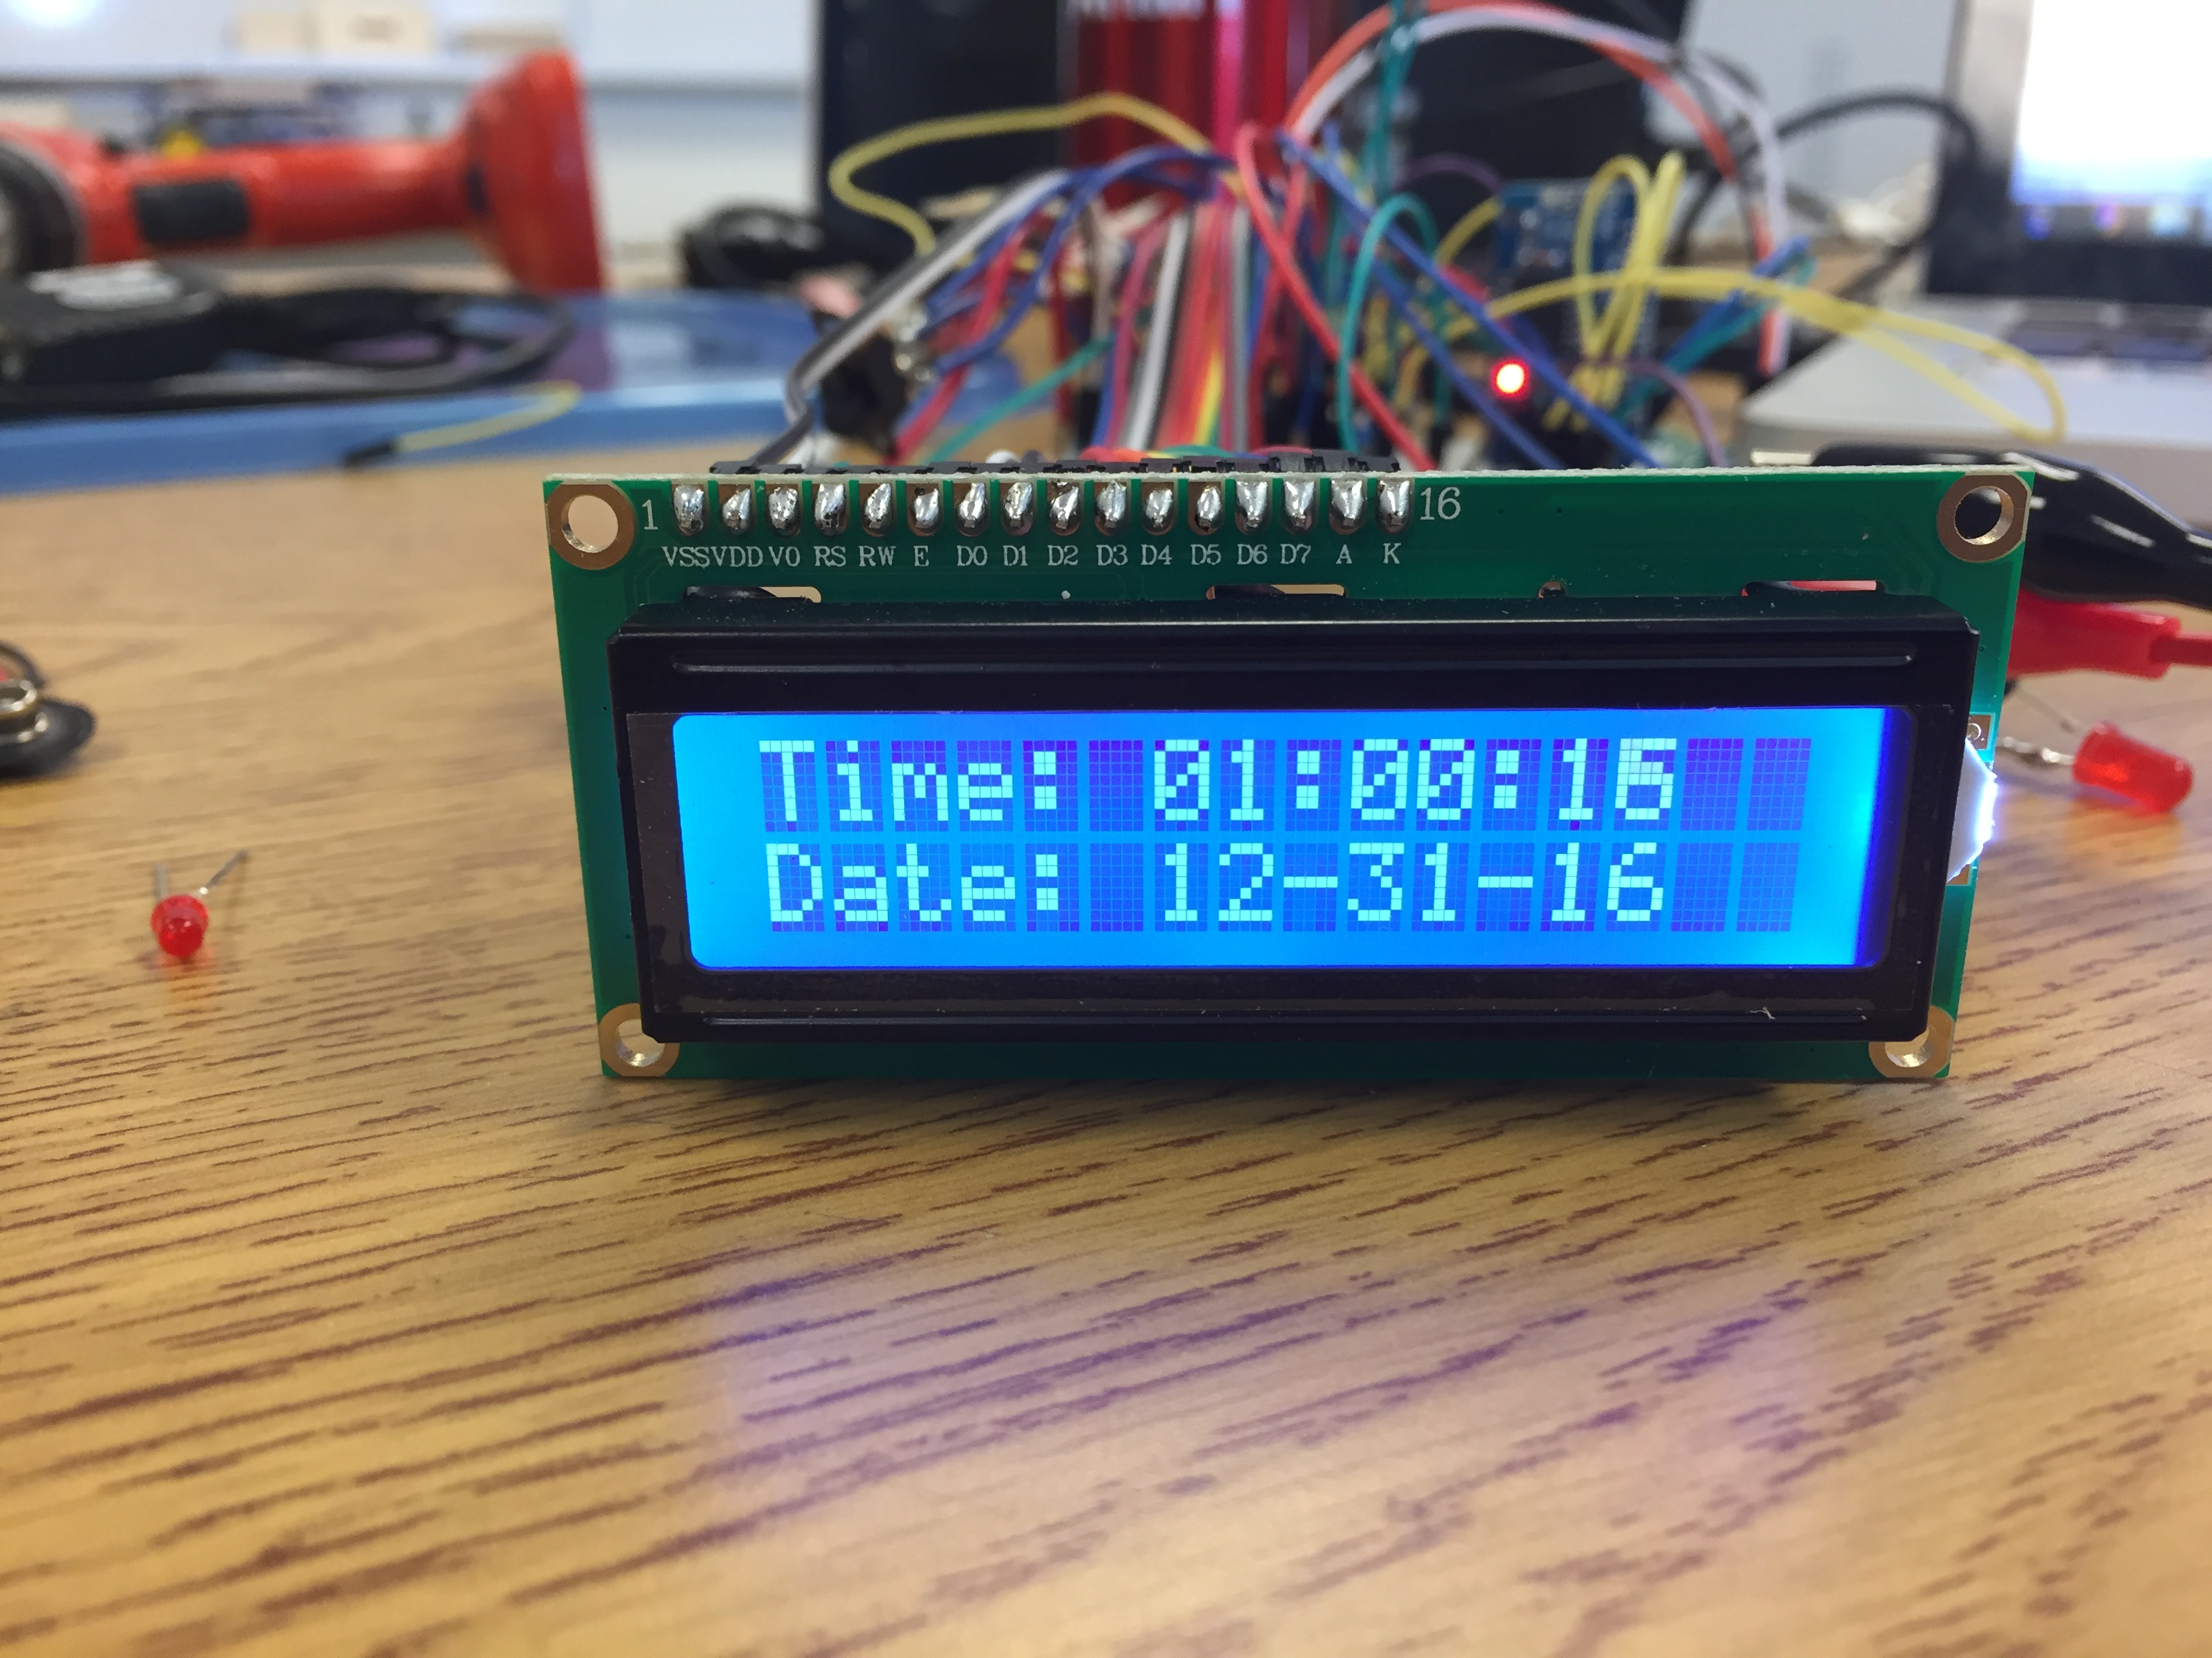
Cables? REALLY?
Got really fed up with the date and time only showing question marks so started to fidget with and test cables
Replaced the RTC but the time still didn’t display
Found a few faulty cables, replaced them, now the date and time work

Slide 5
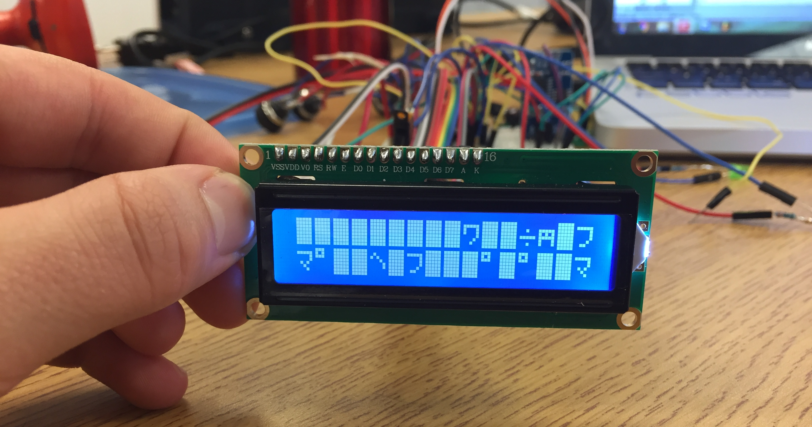
UMMMMM WHAAAAT?
The alarm function doesn’t work at the moment
When I try and set the alarm the screen displays weird and random characters
Removed the resistors that are connected to the RTC except the one connected to the SQW pin and this fixed the character issues

Slide 6
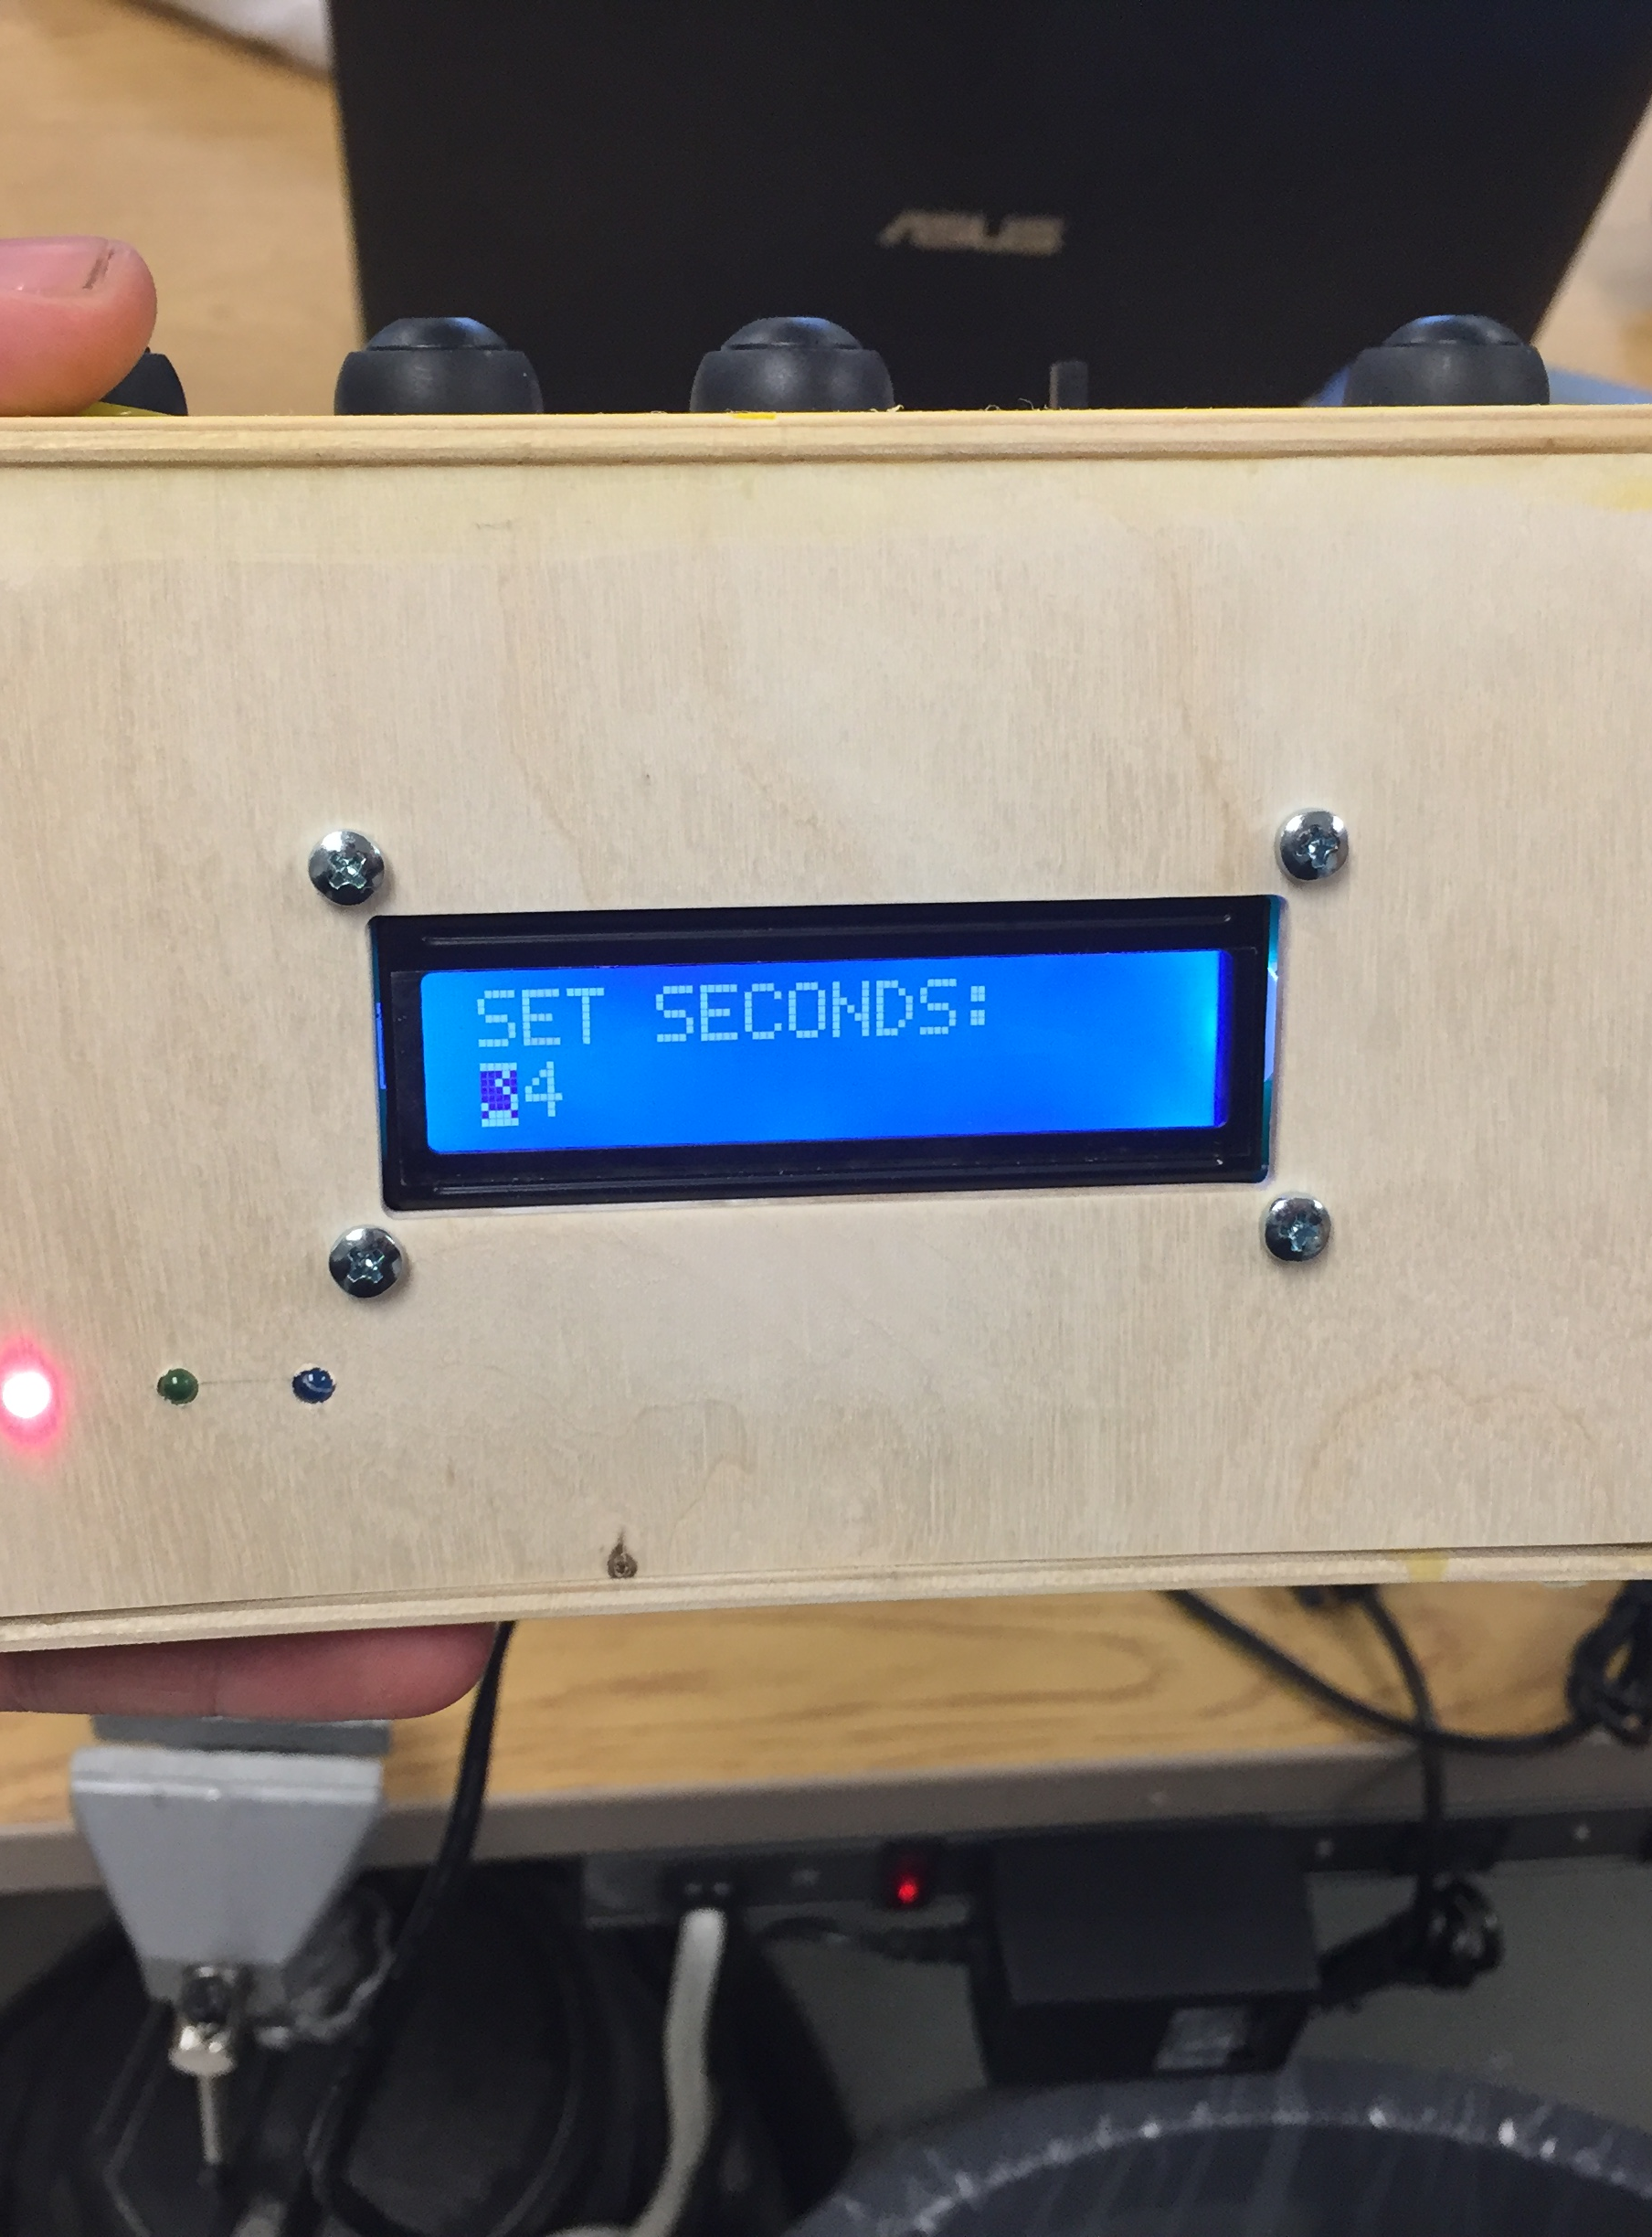
Comment then Uncomment
Now the alarm is able to be set however whenever the time reaches one second before the alarm is supposed to trigger the whole system freeze.
To fix this we commented out the code that was within the interrupt routine and then reprogrammed the MCU
Now the alarm could be set and the system didn’t freeze when it reached the proper time.
Then I uncommented the code and the alarm function worked perfectly

Slide 7
Changing the Code
Once the alarm function worked I hooked up the switch that tells the the MCU whether or not the alarm should be active
This switch didn’t work and after some trial and error I changed 1 line in the code and the switch worked.

Slide 8
Finale
I adjusted the new potentiometer so that I could see the display clear and then glued everything into place.
I now have a working clock that can keep the time and date, as well as set an alarm which when triggered will play the song Galaway Girl by Ed Sheeran

